Slide 1
Interview Process
Python ML based project

Slide 2
Agenda
Introduction
Working strategy
Graphical User Interface (GUI)
GUI in python
Machine Learning
Voice Processing
Conclusion

Slide 3
Introduction
This project purpose is to recruit a person based on test score and experience
Basically, this project compares the score and the experience of the candidate to the history data, analysis whether he/she hire or not.
Also defines the expected salary depends on score and experience, this is done with Machine Learning algorithm and visualize it by using matplotlib.
Whole project is GUI based that gives an interactive interface to user for make himself register and then can take a test and get its score and status with well visualize graphs.

Slide 4
Working strategy
Strategy follows as...
Do login and sing up registration (by a GUI window).
Take test score and experience for salary prediction by Multiple linear regression (MLR).
Visualization of results that compares and show you score and salary.
Also embedded voice assistant working over python package.

Slide 5
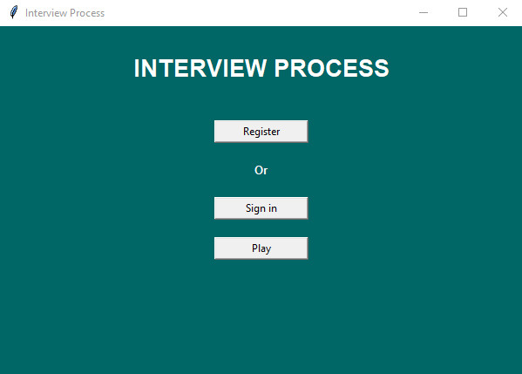
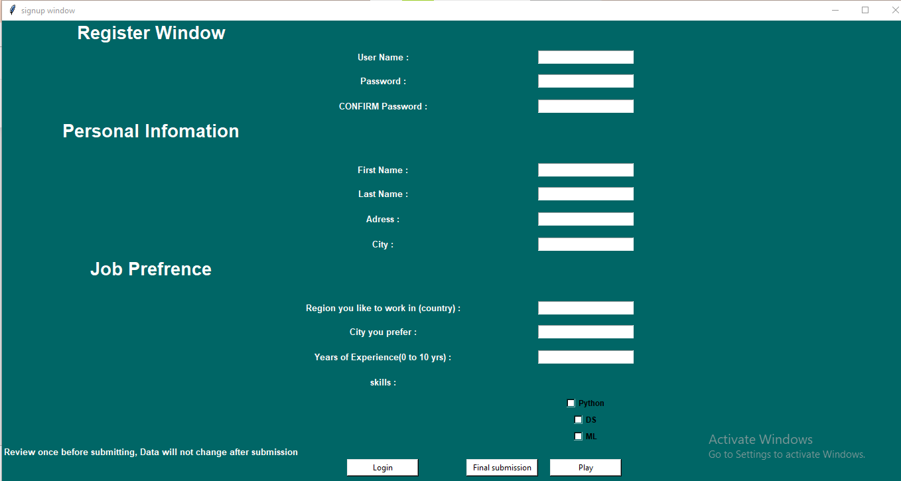
Graphical User Interface (GUI)
Home Page GUI
Registration form

Slide 6
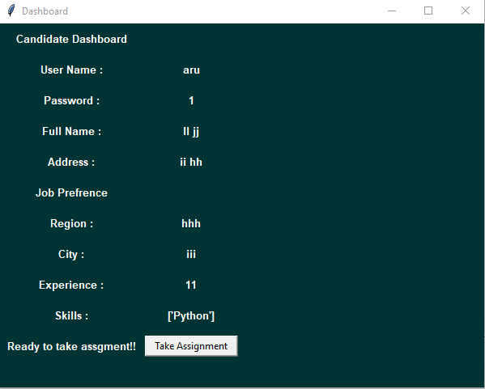
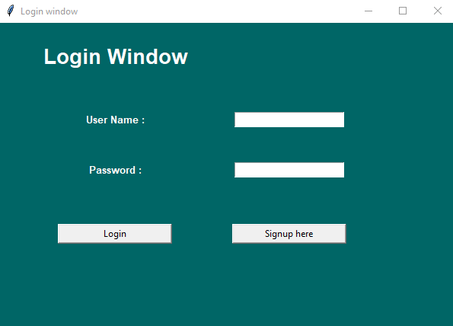
Login GUI windows
Login window
Dashboard consist assignment

Slide 7


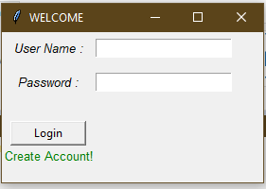
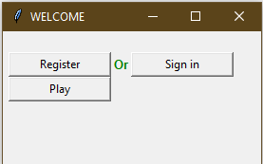




Voice Processing in GUI
After pressing the Play button, It will speak itself, this is part of voice processing.

Slide 8
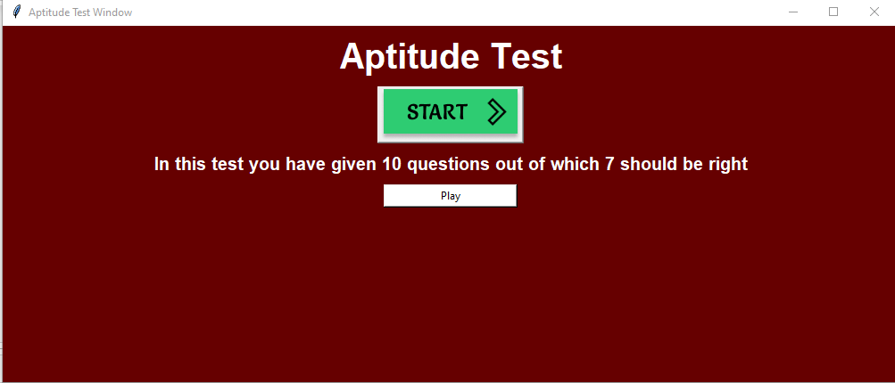
Aptitude Test (GUI window)
After clicking this you start the test
On clicking this you will get question slides
For passing this aptitude test, candidate must give 7 right answers.

Slide 9
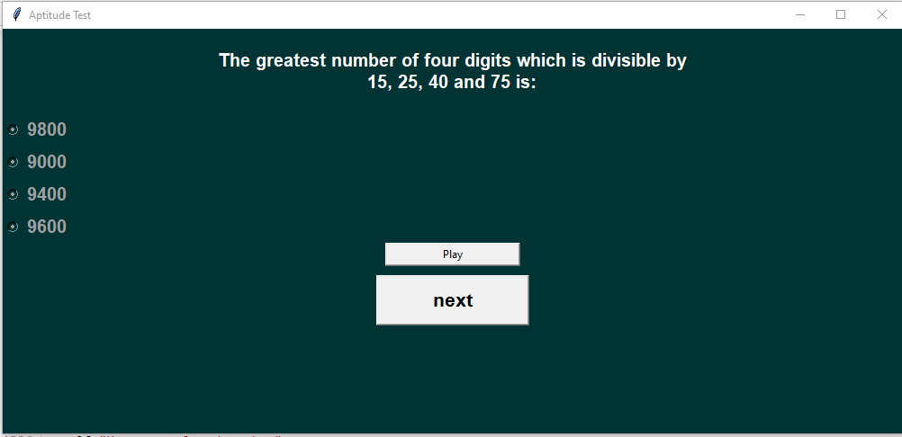
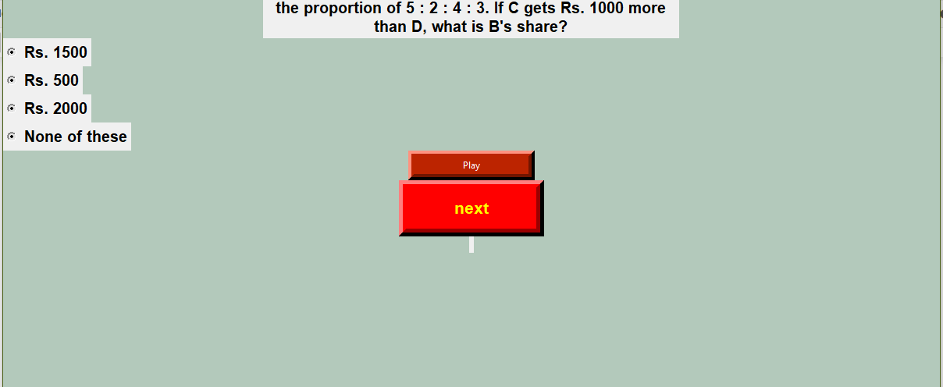
Question slides
It will play the sound
It will add sound to question
This will take you to another question
Move to next question

Slide 10
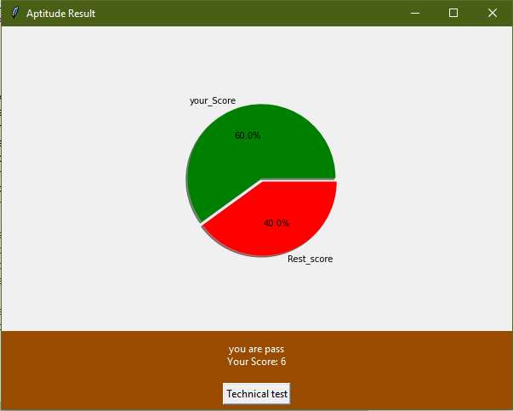
Aptitude Visualization

Slide 11
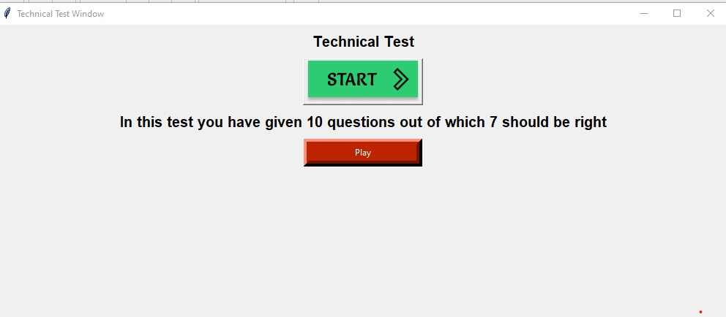
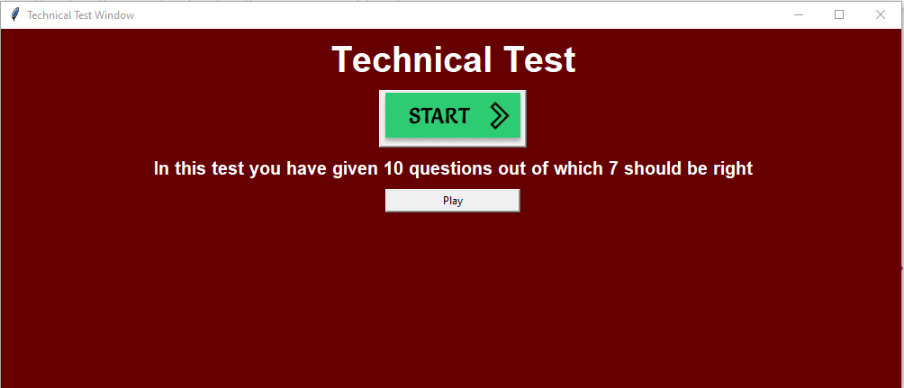
Technical Test (GUI Window)
On clicking this you will get question slides
After passing the aptitude test you will able to take Technical test.

Slide 12
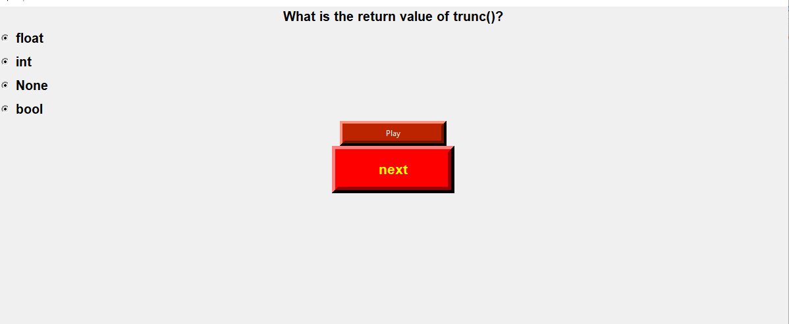
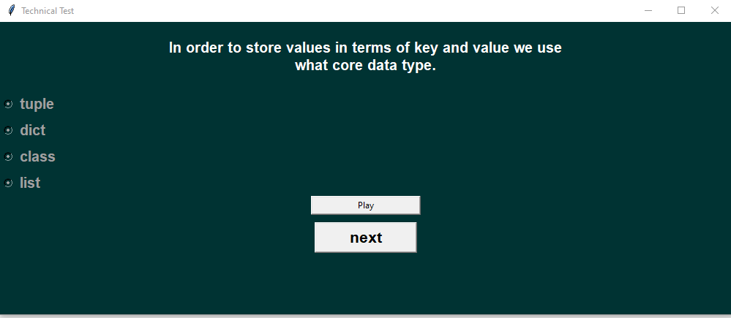
Technical Question Slide
Add sound to question
Take you to another question

Slide 13
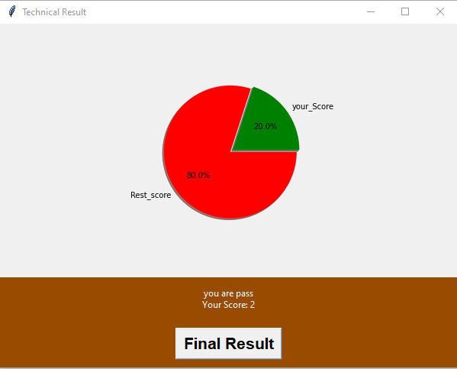
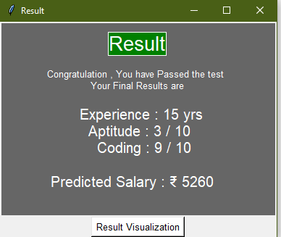
Technical score result visualization

Slide 14
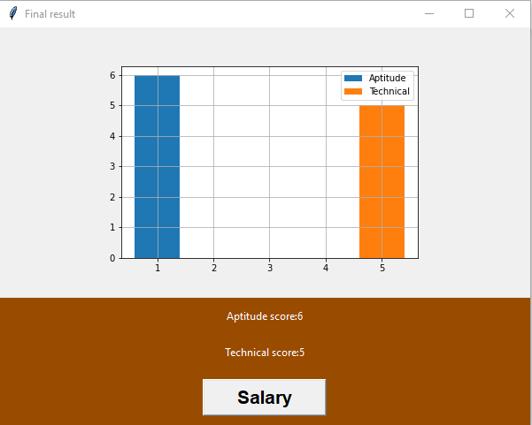
Data Visualization For Test Score
Comparison of both the test scores by Bar chart.

Slide 15
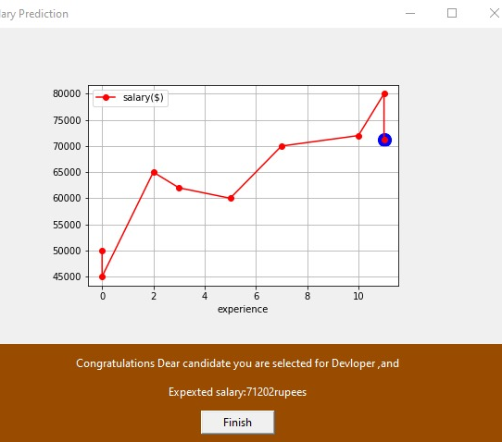
Data comparison with existing data to the current candidate data (Salary prediction by ML)

Slide 16
GUI in Python
Tkinter is the standard Python library for GUI.
Tkinter provides a fast and easy way to create GUI applications.
Tkinter provides a powerful object-oriented interface to the Tk GUI toolkit.
Here we use Labels, button, toggle links and other tkinter functions for creating a well design and an interactive interface.
And save all the data into database easily and provide an easy excess of data too.

Slide 17
Machine Learning
Machine learning (ML) is a type of artificial intelligence (AI) that allows software applications to become more accurate at predicting outcomes without being explicitly programmed to do so.
Machine learning algorithms use historical data as input to predict new output values.
Here we use multivariable Linear regression (MLR) that predict the salary of the candidate.
It uses the scores data and experience data as dataset that is provided in database.

Slide 18
Voice Processing
This assistant creates by Audio Data Handling using Python.
Sound is represented in the form of an audio signal having parameters such as frequency, bandwidth, decibel, etc.
This work over the whole GUI windows and assist you in the test you face.
Here we use Pyttsx3 , Python audio handling package.

Slide 19
What is pyttsx3 in Python?
pyttsx3 is a text-to-speech conversion library in Python. Unlike alternative libraries.
It works offline and is compatible with both Python 2 and 3.

Slide 20
How does Python recognize voice?
Recognition of Spoken WordsPyaudio .
It can be installed by using pip install Pyaudio command. Speech Recognition .
This package can be installed by using pip install Speech Recognition. Google-Speech-API .
It can be installed by using the command pip install google-api-python-client.

Slide 21
What is the use of pyttsx3?
pyttsx3 is a text-to-speech conversion library in Python. Unlike alternative libraries, it works offline and is compatible with both Python 2 and 3. An application invokes the pyttsx3. init() factory function to get a reference to a pyttsx3.Oct 3, 2019

Slide 22
How do I install Speech Recognition?
The easiest way to install this is using pip install Speech Recognition. Otherwise, download the source distribution from PyPI, and extract the archive. In the folder, run python setup.py install.

Slide 23
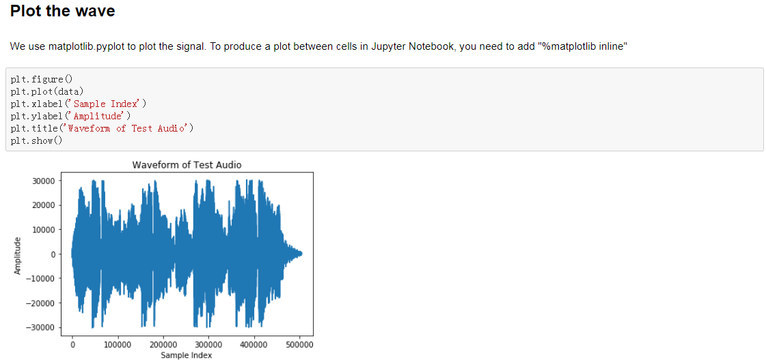
Voice Processing Visualization

Slide 24
Conclusion
This project basically use for recruitment process
It helps company to get candidate data and providing a Quantitative and Technical test series to him/her, so that any organization could easily hire the employee.
Provide fast and easy way to the candidate who going to excess it.

Slide 25
THANKYOU

